Slide 1
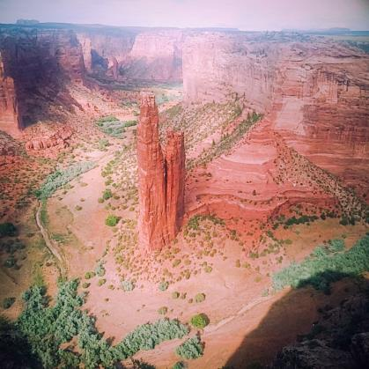
Native Ways of Knowing
Decolonizing Methodologies
Jennifer Jenkins, MLIS, PhD
Southwest Center, University of Arizona
NEH Palimpsest of Cultures 2022

Slide 2
Peoplehood Matrix
Tom Holm, J. Diane Pearson, Ben Chavis. “Peoplehood: A Model for the Extension of Sovereignty in American Indian Studies.” Wicazo Sa Review Volume 18, Number 1, Spring 2003
https://muse.jhu.edu/article/42993/pdf

Slide 3
Terminology: Language Matters
Sovereignty: the inherent human right to self-determination
Peoplehood: group identity (personhood: individual identity)
Indigenous, Native, Indian (NDN), Aboriginal, First Nation: regionally and culturally determined
Tribal/Community names, i.e., Tohono O’odham, Akimel O’odham, Diné, Inde

Slide 4
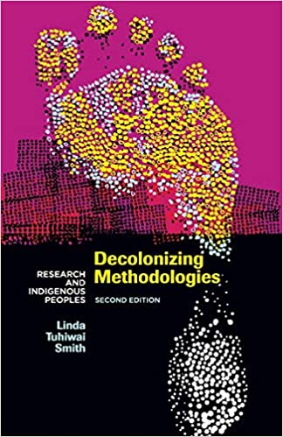
Linda Tuhiwai Smith (Maori), Decolonizing Methodologies (1999)
De-centering Western/Colonial Epistemologies
Foregrounding Native Ways of Knowing
“Choosing the Margins”
Role of Story
Epistemology: theory of knowledge

Slide 5
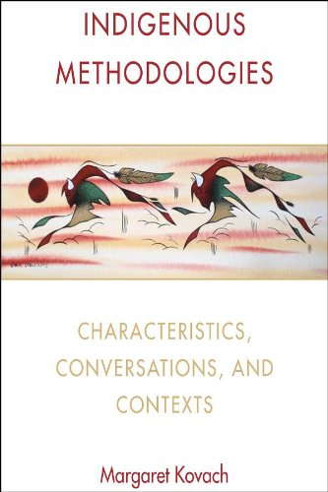
Margaret Kovach, Indigenous Methodologies (2009)
Ch.5: “Story as Indigenous Methodology”
“Stories remind us of who we are”
Identity, Ontology, Epistemology
Ontology: theory of being
i.e., emergence story, charter myth, “In the beginning…”
[light, the Word, God, Big Bang, Conception, Mind, Soul]
*Connection to the land
e.g., Keith Basso, Wisdom Sits in Places: Landscape and Language Among the Western Apache
https://unmpress.com/books/wisdom-sits-places/9780826317247

Slide 6
Museum Context: NAGPRA and the Protocols
NAGPRA: Native American Graves Protection and Repatriation Act (1990). By statute, archaeological recoveries and remains must be returned to Indigenous and descendant groups; museum holdings also covered under NAGPRA. n.b., ancestral seed corn, remains, ceremonial objects, medicine bundles, etc.
Protocols for Native American Archival Material: https://www2.nau.edu/libnap-p/protocols.html
the importance of consultation with and concurrence of tribal communities in decisions and policies
the need to recognize and provide special treatment for culturally sensitive materials
rethinking public accessibility and use of some materials
the role of intellectual and cultural property rights
the need to consider copying, sharing, and/or repatriation of certain materials
the recognition of community-based research protocols and contracts
reciprocal education and training
raising awareness of these issues within the profession

Slide 7
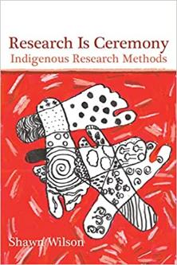
Centering of Story
Story as voice of community rather than individual: implications for epistemologies, histories, ontologies, organization of information
Knowledge-keepers: elders, practitioners
Knowledge: oral, aural, tactile, place-based, embodied
“Relationships don’t just shape Indigenous reality, they are our reality. Indigenous researchers develop relationships with ideas in order to achieve enlightenment in the ceremony that is Indigenous research. Indigenous research is the ceremony of maintaining accountability to these relationships. For researchers to be accountable to all our relations, we must make careful choices in our selection of topics, methods of data collection, forms of analysis and finally in the way we present information.”

