Slide 1
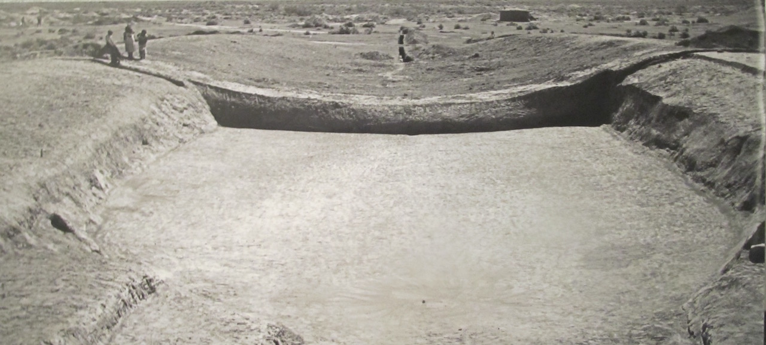
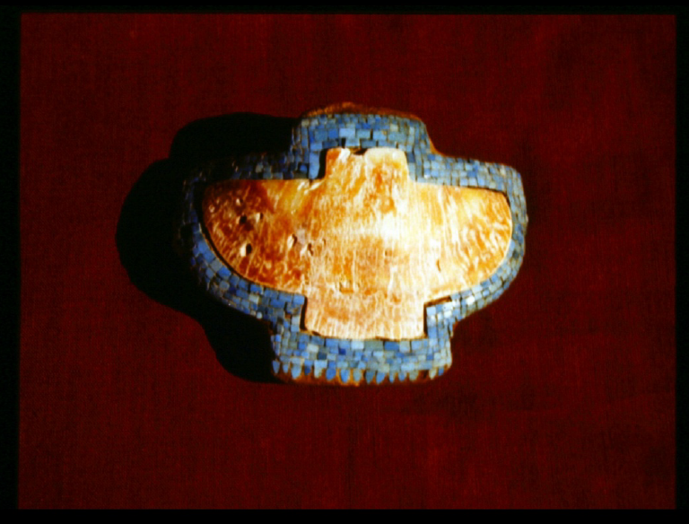
Hohokam Culture
The Short, Swift Time of Gods on Earth
Snaketown ballcourt
Turquoise and abalone ornament
*there are two audio files: one overlaid on the ballcourt, and the second overlaid on the Snaketown caption. Please listen in that order [a coughing fit interrupted the recording!]

Slide 2
How To Approach Reading Cultural Creation Stories
Storytelling is not a solitary activity: group audience, age, gender, and clan variety
Embedded ontologies (theories of being)
Where we come from
Where food comes from
Relationship to the land, directionality
Embedded cultural rules/boundaries: moral code=what is good for the group

Slide 3
Story Provenance
Oral version, time immemorial
Spanish: Pedro Font in 1775 (English translation)
“Smith-Allison Text”: Julian Hayden, 1935 at Snaketown dig [largest font size in the text]
Donald Bahr, 1994: imposing linear settler categories, recrafts the narrative to settler patterns

Slide 4
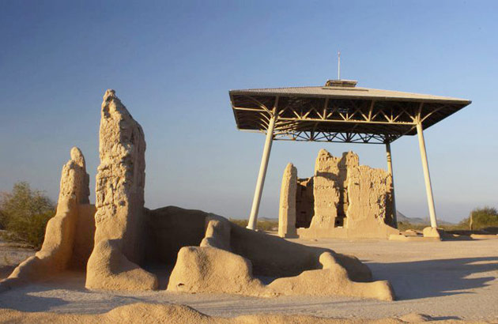
The Short, Swift Time (2)
Cultural Values

Slide 5
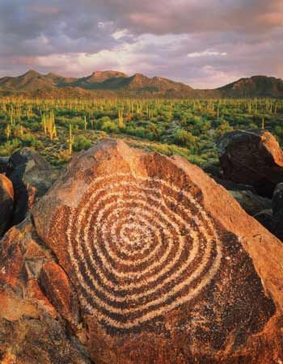
Didactic Values: Culture and Community
Intergenerational Knowledge Transfer
Traditional Knowledge (TK)

Slide 6
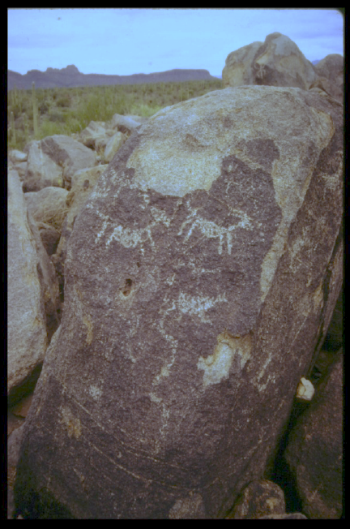
Cannibalism, Infanticide, Parricide, Incest Taboos
Threaten the cohesion of the group
Threaten continuance of the people
Moral Code or Simple Survivance?

